Slide 1
Implementation of Asynchronous Depression Screening and SAFETY PROTOCOLS FOR PSYCHIATRISTS
J. Nathan Copeland, MD, MPH
Rachel Weir, MD
Lisa Rosenthal, MD
Tom Zaubler, MD, MPH
Notes:
Hello. Welcome to our webinar “Implementation of Asynchronous depression screening and safety protocols for psychiatrists. My name is Nathan Copeland, and I am a child psychiatrist at Duke, and we will meet our other speakers in just a few minutes Drs. Rachel Weir, Lisa Rosenthal, and Tom Zaubler very soon. This presentation is brought to you by the American Psychiatric Association’s Committee on Integrated Care.

Slide 2

As this is a short session with lots to cover, we likely will not be able to respond to your question live. However, your questions help us know what to answer in future resources, so please ask them!
Use the “Q&A” area of the attendee control panel to ask questions throughout the presentation:
The slides and recording will be available after the webinar.
All lines are muted.
Contact the Practice Management HelpLine (practicemanagement@psych.org) for specific questions about your practice.
Notes:
First a few house keeping items. This is a short session and we will try to cover a lot. The format will be meeting our speakers and learning a little bit about structure of their asynchronous depression screening program, and then we’ll spend time delving into some of the details of their thoughts on this work. It is possible we may not have time for questions. However, please ask your questions as we may have a little time, and it would provide us guidance about needed resources or educational tools.

Slide 3

Asynchronous depression screening
Notes:
To start with, so we can also be thinking about the same topic, I would like to orient you to the topic of asynchronous depression screening. Asynchronous depression screening involves patients completing validated tools like the PHQ-9 via patient portals or digital apps before or after appointments. An important thing to acknowledge here is that it is the advancement in and uniquity of technology that has allowed for this to occur. Right, we are both able to push these tools out from our electronic health record, and the vast majority of patients have patient portal apps and the technology at home that allows them to complete these screeners. Also, while we are focused on depression assessment and safety today, this method of assessing for mental illnesses can run the full range of conditions including anxiety, ADHD, substance use disorders, and others.

Slide 4
ASYNCHRONOUS DEPRESSION SCREENING
ADVANTAGES | CONSIDERATIONS
HIGHER SCREENING COMPLETION RATES | ENSURING RESOURCES FOR CARE
OPERATIONAL EFFICIENCIES | CLINICIAN AWARENESS OF POSITIVE SCREEN
INCREASED ACCURACY | PROCESS WHEN PATIENT NEED IN-VISIT SCREEN
PRE-VIST AWARENESS OF HEALTH CONDITION | SAFETY PROTOCOLS FOR SUICIDAL IDEATION
EHR TRACKING
STANDARDIZATION
Notes:
And why might you consider implementing asynchronous depression screening? There are many advantages, but there are also considerations (read through). And it is this last point that presents a particular concern and challenge for psychiatrists and health systems. If a patient reports suicidal ideation before or after a visit on a screening scale, we want to ensure safety of that patient, and it is also this concern and challenge that makes many health systems believe the risk, to the health system, the psychiatrists, and the most importantly the patient, is too great to implement asynchronous depression screening.
However, part of the reason we are doing this seminar is there are many systems and psychiatrists in the country that have implemented an asynchronous screening process. And we are going to hear from a few psychiatrists today about how their systems have implemented asynchronous screening and have a conversation about learned lessons and ensuring patient safety in this process.

Slide 5
Rachel Weir, MD
Chief of Mental Health Integration for the Huntsman Mental Health Institute and UTAH Health

Slide 6
Automated depression screening
Pt. portal, 48 hours ahead of visit
PHQ-9
3)…
9)…
ALL POSITIVE
SCORES (10+)
BHI staff: EHR workbench report
PCP: Receives “Depression Risk” BPA
PHQ-2
1)…
2)…
POSITIVE PHQ-2
Minimal
0-4
NEGATIVE
Severe 20+
OR any positive
on question 9
Mild
5-9
Moderate
10-19
End: No
intervention
Pt portal: Automated
Pt. choices/ responses;
BHI team member
offers BHI clinical
services electronically
Phone call from BHI
team member, assesses
and offers BHI clinical
services
Pt portal:
Automated response:
Lifestyle
interventions

Slide 7
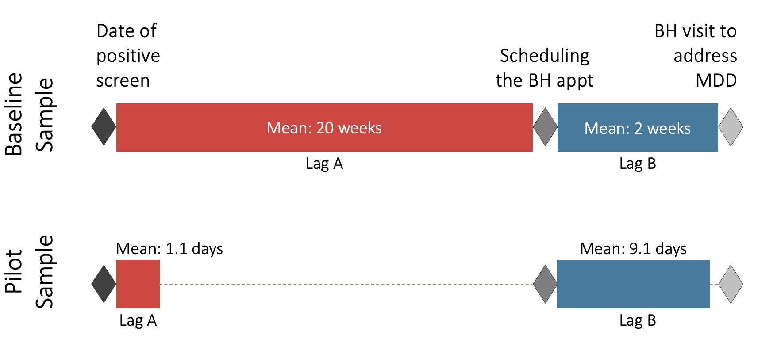
Automated depression screening results
Primary care + Specialty (3/25-2/26):
Pilot results in Specialty clinics (10/22-9/23):
91,178 pts. completed
60.8% pt. completion rate
9,289 pts. (10.1%) with positive score
Next Steps:
Added GAD-2/7 in pilot
Move to “Mental Health risk” BPA

Slide 8
Lisa Rosenthal, md
Chief of Consultation Psychiatry at Northwestern University Feinberg School of Medicine

Slide 9
Northwestern Asynchronous Suicide Screening
Northwestern Medicine Primary Care uses systemwide depression screening by asynchronous and synchronous PHQ2 for eligible visits
  Scores ≥3 signal an OPA to complete the PHQ9 during the visit
The CoCM program at NM has a pilot project using online proactive and asynchronous questions including the PHQ9 initiated at referral
  Goal is clinical outreach within 2 business days post screen or referral, though there is a flag for + question 9
The psychiatry department utilizes proactive pre-visit screening 3 days prior to established outpatient appointments. Depending on diagnosis, includes the full PHQ9
The responses to this questionnaire will be reviewed at the time of your visit. If you are indicating a severe symptom that requires immediate attention, please contact your provider. If you are experiencing a medical emergency or a mental health crisis, including immediate risk of harm to yourself or others, please dial 911 or 988, the Suicide and Crisis Lifeline, or go to your nearest emergency room or facility.

Slide 10
“Omitting a question about suicide is indefensible”
“Instead of worrying about legal liability if health care organizations ask the last question on the PHQ-9, perhaps the real liability lies in not assessing potential suicidality, because failure to treat an at-risk patient is the most common reason psychiatrists are sued.“
Stat News: Kyle Fitzpatrick, Geoffrey Engel, and J. Wesley Boyd. Aug. 14, 2025
  https://www.statnews.com/2025/08/14/phq-9-depression-screen-test-suicide-question-legal-liability-research/
And - the “standard” of an immediate and personal response sets up an impossible paradigm

Slide 11
Tom zaubler, md, mph chief medical officer at neuroflow, FOUNDER AND Medical DIRECTOR OF PEGASUS PSYCHIATRY ASSOCIATES

Slide 12

TECH-AUGMENTED BEHAVIORAL HEALTH INTEGRATION: HOW IT WORKS
POPULATION DATA INPUTS
AI TRIAGE ENGINE
OUTPUTS
📋
PHQ-9 / GAD-7
🧠
🖥️ CLINICIAN DASHBOARD
Validated scales
asynchronously
Patient
Severity
📱
EMA Trackers
Ford, F.
Severe
Mood · sleep · stress
pain · daily check-ins
AI TRIAGE ENGINE
Snyder, S.
Mod. Severe
Bryant, M.
Moderate
📓
Patient Journals
⚡
Real-time AI risk scoring
& severity stratification
Butler, T.
None
Free-text analyzed
by NLP / LLM
►
►
Sorted by acuity · 6.5 min saved/visit
🏥
EHR Records
🔗
NLP + LLM analysis of
free-text journals & notes
📱 PATIENT SUPPORT
ADT feeds · discharge
transition triggers
⚙️
Automated step-care
workflow triggers
📊
Validated assessments
(PHQ-9, GAD-7, EMA)
📊
Claims Data
Utilization · cost
comorb. history
Curated digital CBT
& psychoeducation
ADT & EHR event listeners
📚
📡
🌍
SDOH Data
Social determinants
of health
🚨
Crisis resources
always visible in-app
🛡️
Suicide ideation
alert engine (Q9)
🔄
Continuous measurement
& score feedback loop
1
© 2026 American Psychiatric Association. All rights reserved.

Slide 13
DIGITAL TREATMENT INTERVENTIONS: EVIDENCE-BASED CARE AT EVERY LEVEL OF ACUITY
Severity-triggered algorithms automatically match the right intervention to the right patient at the right time
LOW ACUITY
MODERATE ACUITY
HIGH ACUITY / CRISIS
PHQ-9 / GAD-7 < 10
PHQ-9 / GAD-7 10–14
PHQ-9 Q9 ≥ 1 | Rising Risk
Foundational Journeys
Guided Journeys
Instant Care Team Alert
Bite-sized clinical & wellness modules
Anxiety · depression · PTSD · ADHD
SDOH · stress management
Clinician-led programs maximizing
therapist encounter value
Depression · anxiety · sleep · ADHD
Q9 affirmation → immediate flag
Crisis responder alerted concurrently
Safety planning completed with patient
Therapeutic Journeys (dCBT)
IBH + mHealth Augmentation
Automated Caring Contact
FearFighter — anxiety, panic, phobia (9 sessions)
MoodCalmer — depression (4 sessions)
Chronic pain · insomnia · substance use
Collaborative Care Model + platform
Step-up protocols on score thresholds
Dashboard flags rising risk between visits
Email with 988 & local resources
Delivered in seconds of Q9 trigger
NLP/LLM journal risk stratification
⚙️ EMA trackers · gamification · auto check-ins as scores rise
⚙️ Severity-triggered delivery · behavioral economics · rewards to drive compliance
⚙️ Crisis resources always visible in-app · EMS/police if needed · EHR closed-loop
41%
GAD reduction with
high dCBT engagement
(effect size d=1.15)
85.9%
Reach clinical reduction
vs. 76.4% IBH alone
(p<0.001)
34%
ED utilization decrease
vs. +52% in TAU group
(Jefferson Health)
2
© 2026 American Psychiatric Association. All rights reserved.

Slide 14
OUTCOMES: WHAT THE RESEARCH SHOWS
↓ 34%
41%
24%
55K+
94%
ED utilization
(tBHI vs. +52% in TAU)
GAD-7 reduction
high dCBT engagement
PHQ-9 reduction
high dCBT engagement
SI & rising-risk events
identified
LLM sensitivity
for SI in journals
Jefferson Health
Holley et al. 2024
Holley et al. 2024
NeuroFlow 2021–2023
BMC Psychiatry 2025
Key Study Findings
Remote Screening — Holley et al. IDDB (2024)
12.9% of patients showed rising risk between visits; hidden risk missed entirely by in-clinic-only approach; median 9-day early detection lead time
mHealth Platform — Pardes et al. IDDB (2022)
PHQ-9 dropped 28.5% and GAD-7 dropped 29% at 8 weeks in tBHI cohort; SI dropped from 25% → 14.7% at 8 wks
Digital CBT — Holley et al. IDDB (2024)
Highly engaged patients: 41% GAD reduction (d=1.15); 24% PHQ reduction (d=0.56); higher baseline severity predicted greatest benefit
IBH + mHealth — Holley et al. JMIR (2025)
Significantly more patients reached clinical reduction (85.9% vs 76.4%), response (81.6% vs 73.3%), and remission (74.5% vs 69.4%) vs. IBH alone (all p<0.01)
EMA & Suicidal Ideation — Kampa et al. JTiBS (2025)
Mood: +43% SI risk per 1-pt deterioration; Sleep: +24%; Stress: +29%; n=30,725 users; real-time, location-agnostic risk prediction
GPT Models for SI Risk — Holley et al. BMC (2025)
Ensemble LLM: 65.6% exact agreement with clinicians; 94% sensitivity, 91% specificity; ~20x faster than human raters
3
© 2026 American Psychiatric Association. All rights reserved.

