Slide 1
American Psychiatric Association practice guideline for the prevention and treatment of delirium
Second edition

Slide 2
Guideline Development Process

Slide 3
Practice guideline development process
Systematic Review of Literature
Evidence Review
Guideline Statements and Text Development
Public Review and Comment
Revisions
APA Assembly and Board of Trustees Approval
Publication

Slide 4
Rationale for This guideline

Slide 5
Prevalence of delirium
Prevalence of delirium varies with the care setting and patient age
In hospitalized older adults
up to one-quarter have delirium on admission
An additional 30% develop delirium during the hospital stay

Slide 6
Mortality, cost, and impact of delirium
Poorer patient outcomes: greater mortality, longer hospital stay, risk of prolonged cognitive impairment
Added costs of delirium in the US: $6.6 to $82.4 billion annually for hospitalized inpatients and $32.9 billion annually for post-operative patients as of 2019
Patients with hyperactive delirium need at least 240 minutes of additional personnel time expended each day of hospitalization
Significant impact of delirium on patients and caregivers: psychosocial distress (anxiety, depression, PTSD), persistent cognitive effects, added healthcare costs
Notes:
* Based on 2019 data.

Slide 7

This practice guideline focuses on
Preventing the development of delirium in at-risk individuals and improving the quality of care for patients with delirium, thereby reducing the mortality, morbidity, and significant psychosocial and health consequences of delirium
https://www.psychiatryonline.org/doi/book/10.1176/appi.books.9780890428023

Slide 8
Assessment and treatment planning

Slide 9
Statement 1 – Structured Assessments for Delirium
APA recommends (1C) that patients with delirium or who are at risk for delirium undergo regular structured assessments for the presence or persistence of delirium using valid and reliable measures.

Slide 10

Need for delirium screening
Delirium, particularly hypoactive delirium and in acute hospital settings, is often unrecognized
Research suggests that even highly trained health care professionals may be prone to overlooking delirium in the absence of validated screening tools.

Slide 11
Delirium Screening Tools
Assessment tool | Items | Estimated time (min) | Multiple languages | Use | Training needed | Non-verbal pts | Free **
4AT | 4 | 2 | Y | Screen | N | Y | Y
CAM Long-form | 9 | 10–15 | Y | Screen; Dx | Y | N | Y
CAM Short form | 9 | 3–5 | Y | Screen | Y | N | Y
CAM-ICU | 9 | <5 | Y | Screen; Dx | N | Y | Y
3D-CAM | 20 | 2–5 | Y | Dx, Severity | N | N | Y
DRS-R-98 | 16 | 20–30* | Y | Screen, Dx, severity | Y | N | Y
ICDSC | 8 | 7–10 | Y | Screen | N | -- | Y
MDAS | 10 | 10–15 * | -- | Severity | -- | N | Y
NuDESC | 5 | <2 | Y | Screen | Y | Y | Y
NH-CAM | 9 | 5 | -- | Screen | Y | Y | Y
* Requires chart review, input from staff, other information prior to completion
** May require permission

Slide 12
Statement 2 – Determination of Baseline Neurocognitive Status
APA recommends (1C) that a patient's baseline neurocognitive status be determined to permit accurate interpretation of delirium assessments.

Slide 13
Determining BASELINE NEUROCOGNITIVE STATUS
To identify preexisting impairment
  Hospitalized patients have a significant prevalence of preexisting cognitive impairment (up to one-third of ICU patients >65 yo).
  The likelihood of developing delirium is increased by preexisting cognitive impairment (e.g., intellectual developmental disorder, stroke, traumatic brain injury, dementia, or other degenerative CNS disease).
To establish diagnosis
  In DSM-5-TR, the criteria for delirium require that "the disturbance …. represents a change from baseline attention and awareness”.
  Cognitive changes may be erroneously disregarded if viewed as due to the patient's baseline cognitive impairment.
To adjust interventions, if needed
  Interventions, such as orienting the patient or providing education, may require adjustment for preexisting cognitive impairments.

Slide 14
Determining BASELINE NEUROCOGNITIVE STATUS
Obtain information as early as possible
With elective surgeries that are associated with high rates of delirium, consider pre-operative cognitive screening test (e.g., MOCA)
With other patients, get information early in the hospital course to reduce confounding effects of retrospective recall
Obtain information from:
  family members or others who are part of the patient's support network
  prior medical records
  input from primary care clinician or other clinicians who know the patient well

Slide 15
Statement 3 – Review for Predisposing or Contributing Factors
APA recommends (1C) that patients with delirium or who are at risk for delirium undergo a detailed review of possible predisposing or contributing factors.

Slide 16
possible predisposing/contributing factors
Demographic factors | Advanced age; residing in structured setting
Aspects of history | Prior delirium
Co-occurring conditions Psychiatric disorders | Cognitive impairment, including dementia; alcohol or other substance use disorders; depressive disorders
Other central nervous system abnormalities | Cerebrovascular disease, including prior stroke; Alzheimer's disease; Parkinson's disease; traumatic brain injury; meningitis or encephalitis; vasculitis; seizure disorder; other central nervous system disorders
Other medical illnesses | Infection; sepsis; cardiovascular disease; pulmonary disease; kidney disease; hepatic failure; diabetes mellitus; other endocrine abnormalities; metastatic disease; paraneoplastic syndromes; obstructive sleep apnea

Slide 17
possible predisposing/contributing factors
Commonly implicated medications and other substances | Benzodiazepine or other sedatives; medications with anticholinergic properties; opioid analgesics, including meperidine; corticosteroids; immunosuppressive agents; sympathomimetics; misused or abused substances (e.g., synthetic cannabinoids, alcohol, cocaine, opioids); herbal medications or nutraceuticals; use of multiple medications; toxins (e.g., heavy metals, pesticides, solvents, carbon monoxide)
Medication related toxicities | Neuroleptic malignant syndrome; serotonin syndrome; toxicity with elevated serum levels (e.g., lithium, valproic acid, carbamazepine, amiodarone, digoxin, phenytoin, salicylate); medication related metabolic disturbances (e.g., hyponatremia related to antidepressants or carbamazepine, hyperammonemia related to valproic acid)

Slide 18
possible predisposing/contributing factors
Physiological abnormalities | Hypotension; anemia or significant blood loss, including situations requiring blood transfusions; metabolic disturbances (e.g., sodium, calcium, magnesium, phosphate abnormalities); acid-base abnormalities; hyperammonemia; hypoglycemia; elevated BUN/Creatinine; hypoxemia; malnutrition or hypoalbuminemia; vitamin deficiency (e.g., thiamine, vitamin B6, vitamin B12)
Sensory or functional impairments | Visual impairment; hearing impairment; immobility; frailty; other functional impairments
Factors related to urgent/emergent procedures | High ASA status; recent surgical complications, including cardiopulmonary complications; operative times; anesthesia type and depth; prolonged time on cardiac bypass

Slide 19
possible predisposing/contributing factors
Factors related to hospitalization | High illness severity (e.g., with elevated APACHE or SOFA score); use of indwelling bladder catheter; use of mechanical ventilation
Other factors | Fever; dehydration; constipation including fecal impaction; urinary retention; new pressure ulcers; hyper- or hypothermia; sleep deprivation or sleep-wake cycle disturbance; social isolation; lack of a familiar environment; environmental overstimulation

Slide 20
LABORATORY TESTS AND OTHER STUDIES - Commonly done
  Vital signs (pulse, blood pressure, respiratory rate, temperature; orthostatic pulse and blood pressure if indicated)
  Pulse oximetry
  Complete blood count with differential
  Glucose measurement
  Comprehensive metabolic panel
  Urinalysis

Slide 21
LABORATORY TESTS AND OTHER STUDIES - sometimes done
Depending on history, clinical findings, and results of other evaluations
Magnesium
Phosphate
Creatine phosphokinase (CPK)
Ammonia
Thyroid stimulating hormone (TSH)
Vitamin B12; methylmalonic acid, as indicated
Thiamine
Serum levels of medications (e.g., lithium, valproic acid, carbamazepine, amiodarone, digoxin, phenytoin, salicylate)
C-reactive protein and/or erythrocyte sedimentation rate (ESR)
Antinuclear antibody (ANA)
COVID-19 test
HIV test
Syphilis test
Blood gases
Cultures (e.g., urine, blood, sputum, wound, cerebrospinal fluid)
Blood alcohol level
Urinary toxicology screen
Bladder scan
Abdominal X-ray/KUB
Chest X-ray
Neuroimaging (e.g., brain magnetic resonance imaging [MRI], head computed tomography [CT])
Electroencephalogram (EEG)
Lumbar puncture

Slide 22
Statement 4 – Review of Medications
APA recommends (1C) that a detailed medication review be conducted in patients with delirium or who are at risk for delirium, especially those with preexisting cognitive impairment.

Slide 23
Review of medications
Review psychiatric and non-psychiatric medications
Look for medications that may have changed recently (started, stopped, dose adjustments)
Consider effects of medications related to basic pharmacological principles:
  Long half-lives
  Active metabolites
  Interactions at metabolic or transport enzymes/sites
  Pharmacokinetic effects on absorption (e.g., s/p GI surgery), volume of distribution (body fat composition), elimination (e.g., renal, hepatic)
  Pharmacodynamic effects (e.g., cholinergic, dopaminergic with age)
Identify medications that may not be needed or that may require dose adjustments

Slide 24
Statement 5 – Use of Restraints
APA recommends (1C) that physical restraints not be used in patients with delirium, except in situations where injury to self or others is imminent and only:
- after review of factors that can contribute to racial/ethnic and other biases in decisions about restraint;
- with frequent monitoring; and
- with repeated reassessment of the continued risks and benefits of restraint use as compared with less restrictive interventions.

Slide 25

use of physical restraints May be…
Associated with potential harms
  e.g., pressure ulcers, fractures, cardiac arrhythmias, musculoskeletal injuries, deep vein thrombosis, aspiration pneumonia, worsening of agitation
  Risks are greater in those with impaired consciousness, as in patients with delirium, or in patients with some existing conditions
Distressing to patients and families
  PTSD may occur in those who have been physically restrained

Slide 26
Before use of physical restraints
Weigh risks against the intended benefits of restraint use as compared with other possible interventions
Risks/harms
Benefits
Safety of the patient and others is a top priority

Slide 27
Use Other interventions first
Treat underlying contributors to delirium or other factors that may be affecting agitation, such as pain or co-occurring psychiatric conditions
Except in an urgent or emergent situation, attempt other interventions
  Environmental modifications for a more calming environment (e.g., turning off TV)
  Addressing issues of comfort to reduce agitation (e.g., pain, urinary retention, hunger)
  Use of nonpharmacological approaches such as educating family members
  Verbal de-escalation techniques in a respectful manner
  Judicious use of medication

Slide 28
Limited use of physical restraints
Be aware of biases that may influence decision-making
  Black patients more likely to be physically restrained than White patients in a U.S. sample of acute care hospital discharges
The type of restraint chosen should be targeted to the patient’s circumstances and be as minimally restrictive as possible (e.g., use of mittens)
Be as brief as possible
Repeatedly reassess patients' status
Monitor the patient closely while physical restraints are in place, including physiological monitoring (e.g., vital signs), assessment of psychological symptoms in response to restraints, and attention to nutrition, hydration, or elimination needs while restrained

Slide 29
Statement 6 – Person-Centered Treatment Planning
APA recommends (1C) that patients with delirium have a documented, comprehensive, and person-centered treatment plan.

Slide 30
Factors to consider for person-centered treatment planning: Medical Interventions, including Medication Review
Addressing likely contributors to the patient's delirium
Reviewing and, if indicated, adjusting medications, including long-acting (e.g., injected, implanted) or OTC medications, herbal products, or nutraceuticals
Obtaining laboratory, imaging, or other evaluations to identify unrecognized contributors to the patient's delirium
Ensuring pulmonary care, assessing for hypoxia and providing supplemental oxygen, CPAP, or ventilatory support as needed
Correcting abnormalities in blood pressure, severe anemia, electrolytes, glucose, fluid, and acid-base status, insofar as possible
Assessing for medical contributors to pain or distressing somatic symptoms
Conducting regular assessments for potential complications of delirium
Identifying and addressing co-occurring psychiatric disorders, side effects of medications, withdrawal symptoms related to recent use of substances
Notes:
- Unrecognized contributors to the patient's delirium may include factors such as infection, cardiorespiratory disease, thromboembolism, abdominal processes, head injury, medication-related toxicity, or substance use.
- Medical contributors to pain and distressing somatic symptoms may include postoperative pain, decubitus ulcers, degenerative joint disease, dyspnea, nausea, constipation, urinary retention, dehydration, dry mouth, and fever.
- Potential complications of delirium may include injury due to falls, pressure sores, dehydration, malnourishment, infection, venous thromboembolism, and, if applicable, postoperative or immobility-related complications.
- Side effects of medications that may contribute to agitation include akathisia related to antipsychotic medications.
- Withdrawal symptoms can occur related to recent use of substances including nicotine, marijuana, alcohol, sedative-hypnotics, and opioids.

Slide 31
Factors to consider for person-centered treatment planning: PSYCHOSOCIAL SUPPORT AND ENGAGEMENT
Assessing mental status on an ongoing basis for persistence or resolution of delirium, including a plan for follow-up assessment if it persists at discharge
Providing easily readable aids to orientation and reorientation (e.g., clock, whiteboard with date)
Ensuring availability and adequacy of dentures, glasses, hearing aids, or assistive devices
Optimizing communication (e.g., use of communication technologies or translation services)
Providing appropriate levels of social interaction, including family engagement
Identifying and addressing psychological contributors to distress
Providing education about delirium to patients, insofar as possible, and to family members and others in the patient's support network
Notes:
- Psychological contributors to distress can include fear, boredom, over- or under-stimulation, co-occurring psychiatric conditions, responses to caregiver dynamics, and frustration with hospital requirements and constraints.

Slide 32
Factors to consider for person-centered treatment planning: PERSONAL CARE AND ENVIRONMENTAL INTERVENTIONS
Ensuring early mobility
Scheduling and aiding with toileting, if necessary
Providing adequate hydration and assistance with meals, if necessary
Reviewing lines, tubes, monitoring cables, restraints, and other "tethers" and removing those that are not needed
Minimizing devices with audible alarms that can produce "alarm fatigue"
Providing an increased level of supervision and support, if necessary
Preventing potential complications of delirium
Considering personal and environmental factors that could be contributing to patient discomfort or distress
Notes:
- Minimizing disruptions to the sleep-wake cycle can be achieved by ensuring adequate daytime lighting, providing ear plugs or eye masks, and minimizing as much as possible nighttime medication doses, blood draws, vital signs, and the number of continuous infusions with associated IV pump alarms.
- Potential complications of delirium can include falls, pressure sores, dehydration, malnourishment, infection, venous thromboembolism, and, if applicable, postoperative or immobility-related complications.
- Personal and environmental factors that could be contributing to patient discomfort or distress may include hunger/thirst, feeling hot/cold, uneven mattress or bedclothes, foreign objects left in bed, or a need for repositioning.

Slide 33
Nonpharmacological interventions

Slide 34
Statement 7 – Multicomponent Nonpharmacological Interventions
APA recommends (1B) that patients with delirium or who are at risk for delirium receive multicomponent nonpharmacological interventions to manage and prevent delirium.

Slide 35
Nonpharmacological interventions
An essential element in prevention of delirium
Evidence is less compelling for management of delirium but typically considered good clinical practice and unlikely to be harmful

Slide 36
Nonpharmacological interventions
Typically delivered as a bundle of multiple components in different combinations
ABCDEF bundle and Hospital Elder Life Program (HELP) most widely studied
Overall, meta-analysis showed significant reduction in delirium risk (risk ratio 0.74; 95% CI 0.61, 0.89)
Studies showed greater benefits with a greater number of nonpharmacological interventions

Slide 37
MULTICOMPONENT BUNDLES
Core Component | ABCDEF Bundle | HELP | NICE | SIGN
Assessment, prevention, and management of delirium | X |  | X | X
Assessment, prevention, and management of pain | X |  | X | X
Early mobilization | X | X | X | X
Daily removal of sedation and ventilation in ICU | X
Review medications and optimize medication choice | X |  | X | X
Vision protocol |  | X |  | X
Hearing protocol |  | X | X | X
Oral volume repletion/feeding assistance |  | X | X | X
Sleep enhancement |  | X | X | X
Daily visitor/orientation |  | X | X | X
Therapeutic activities |  | X | X
Family engagement | X |  | X | X

Slide 38
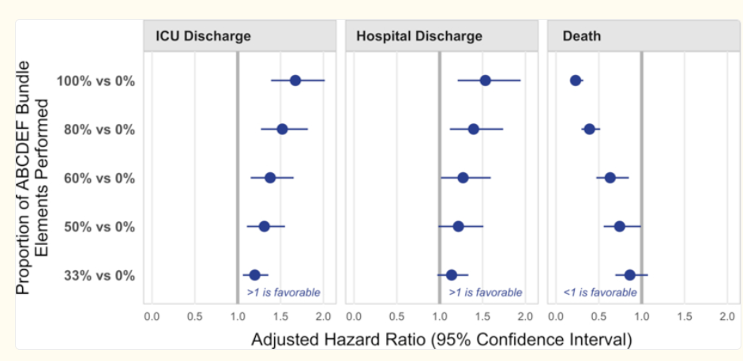
MULTICOMPONENT BUNDLES
Pun and colleagues found an improved likelihood of ICU or hospital discharge and a reduced likelihood of death when a greater proportion of A to F bundle elements were performed (Crit Care Med 47:3-14, 2019 PMID: 30339549).

Slide 39
Successful implementation of Nonpharmacological interventions
Concerted and consistent efforts on a unit or organizational level
Providing adequate nursing staffing
Assuring intervention fidelity
Supporting staff and organizational leadership
Integrating components with existing programs (e.g., geriatric care)
Identifying ways to help ensure the delivery of interventions (e.g., rounding checklists)
Using data to assess program outcomes and benefits (e.g., decrease in delirium)
Changing organizational culture related to delirium assessment and interventions

Slide 40
Pharmacological interventions

Slide 41
Statement 8 – Principles of Medication Use
APA recommends (1C) that medications, including antipsychotic agents, be used to address neuropsychiatric disturbances of delirium only when all the following criteria are met:
- verbal and nonverbal de-escalation strategies have been ineffective;
- contributing factors have been assessed and, as far as possible, addressed; and
- the disturbances cause the patient significant distress and/or present a risk of physical harm to the patient or others.

Slide 42
Medication Use
Limited evidence from RCTs on the benefits of medications in the treatment of delirium
Expert consensus suggests that judicious use of medications can be appropriate and helpful in calming a patient with significant neuropsychiatric disturbances
It may help in avoiding the use of physical restraint or reducing duration of restraint time

Slide 43
If medication is considered
Be aware of biases that can influence decision-making regarding neuropsychiatric disturbances of delirium
Weigh possible benefits versus potential harms of medications in reducing distress or agitation
Duration of medication should be as brief as possible
Address neuropsychiatric disturbances of delirium by correcting underlying contributors or using nonpharmacological approaches first

Slide 44
PRINCIPLES OF ANTIPSYCHOTIC USE
If needed, choose a specific medication based on:
  Available administration route
  Medication properties (e.g., side effect profile, pharmacokinetics)
  Concomitant conditions that would be affected by specific side effects
Additional considerations:
  Start at ½ or lower dose than typical adult starting doses
  Adjust for age and renal/hepatic function
  Allow adequate time for effect before giving additional doses
  Use lowest possible dose for shortest possible time
  Use short-term orders so that reassessment will be needed

Slide 45
Statement 9 – Antipsychotic Agents
APA recommends (1C) that antipsychotic agents not be used to prevent delirium or hasten its resolution.

Slide 46
Minimize use of ANTIPSYCHOTIC MEDICATIONS
Lack of evidence for benefits in preventing or treating delirium
Potential risks with antipsychotic medication treatment
Use of an antipsychotic is NOT recommended to prevent or treat delirium.
Judicious use of an antipsychotic can be appropriate to reduce harm to self or others when neuropsychiatric disturbance is severe.

Slide 47
ANTIPSYCHOTIC MEDICATIONS evidence
In post-operative patients
  a benefit of antipsychotic medication in reducing the incidence of delirium but little or no effect on the duration or severity of delirium
In ICU patients
  a small effect on the duration of delirium but no difference in delirium incidence.
In general inpatients
  no effect of antipsychotic on delirium incidence, duration, or severity.

Slide 48
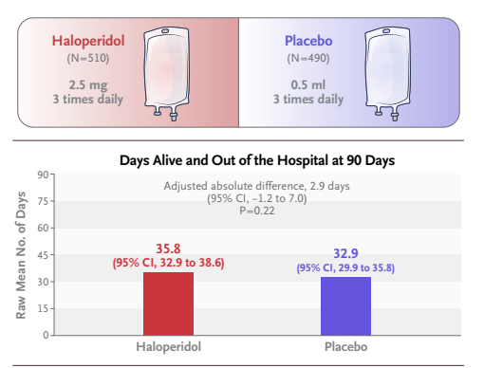
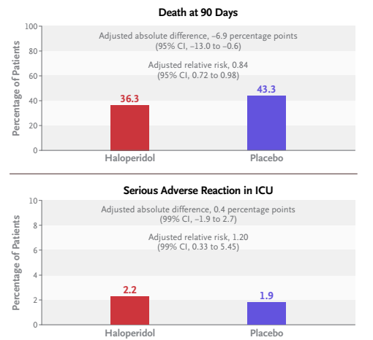
ANTIPSYCHOTIC MEDICATIONS evidence
Total N=1,000 patients
Andersen-Ranberg NC, et al. Haloperidol for the Treatment of Delirium in ICU Patients. N Engl J Med. 2022 Dec 29;387(26):2425-2435. PMID: 36286254.

Slide 49
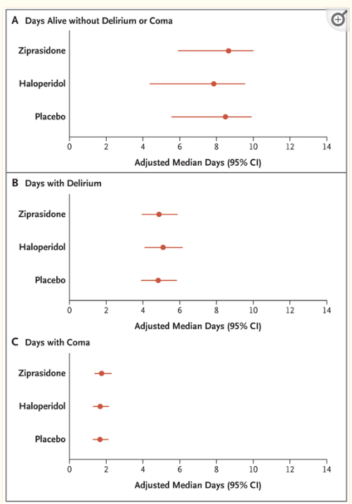
ANTIPSYCHOTIC MEDICATIONS evidence
MIND-USA study
  Girard TD, et al. Haloperidol and Ziprasidone for Treatment of Delirium in Critical Illness. N Engl J Med. 2018 Dec 27;379(26):2506-2516. PMID: 30346242
Informed consent obtained for 1,183 of whom 566 developed delirium (48%)
89% had hypoactive and 11% had hyperactive delirium.
184 received placebo, 192 haloperidol (20 mg/day max), 190 ziprasidone (40 mg/day max).
The median duration of exposure to a trial drug or placebo was 4 days (interquartile range, 3-7).

Slide 50

Potential side effects with antipsychotics
Side effects of antipsychotic medications vary with the specific agent and are typically dose dependent
  With short-term use of an antipsychotic to address neuropsychiatric disturbances of delirium, specific side effects include sedation, anticholinergic effects, and orthostatic hypotension.

Slide 51
Other side effects with antipsychotics
QTc interval prolongation
Akathisia: may be mistaken for agitation
Parkinsonism
Oropharyngeal dysphagia: may lead to an increased risk of aspiration pneumonia
Dystonic reactions
Neuroleptic malignant syndrome (NMS): rare, but can be life threatening
Dyskinesia and other motor syndromes: can occur with relatively short periods of treatment, though typically related to longer-term treatment with an antipsychotic (i.e., tardive dyskinesia or other tardive motor syndromes)

Slide 52
Statement 10 – Benzodiazepines
APA recommends (1C) that benzodiazepines not be used in patients with delirium or who are at risk for delirium, including those with preexisting cognitive impairment, unless there is a specific indication for their use.

Slide 53
Minimize use of benzodiazepines
No benefits of benzodiazepine treatment compared with other options
  Limited number of randomized studies of midazolam or lorazepam in the treatment or prevention of delirium
  Greater incidence and duration of delirium with midazolam vs. dexmedetomidine
  In ICU patients, somewhat greater duration of mechanical ventilation with midazolam vs. dexmedetomidine
Potential risks of side effects with benzodiazepines in older individuals and those with preexisting cognitive impairment
  Increased risk of falls, oversedation, respiratory depression

Slide 54
POTENTIAL BENZODIAZEPINE INDICATIONS
High likelihood of alcohol or sedative-hypnotic withdrawal by clinical history and symptoms
Acute intoxication from anticholinergic agents, stimulant use, psychedelic drugs, or multiple unknown substances
Prominent signs of catatonia
Neuroleptic malignant syndrome
Serotonin syndrome
Autoimmune encephalitis
Long-standing use of a benzodiazepine before hospitalization for which discontinuation may prompt withdrawal symptoms or symptom rebound
Seizure disorder that requires the use of a benzodiazepine for adequate seizure control

Slide 55
Statement 11 – Dexmedetomidine to Prevent Delirium
APA suggests (2B) that dexmedetomidine be used rather than other sedating agents to prevent delirium in patients who are undergoing major surgery or receiving mechanical ventilation in a critical care setting.

Slide 56
Statement 12 – Dexmedetomidine in Patients with Delirium
APA suggests (2C) that when patients with delirium are sedated for mechanical ventilation in a critical care setting, dexmedetomidine be used rather than other sedating agents.

Slide 57
DEXMEDETOMIDINE – BENEFITS
- Shorter periods of mechanical ventilation and shorter ICU/hospital length of stay vs. placebo or other sedations in some studies
- Faster resolution of delirium and fewer days with delirium in mechanically ventilated critical care patients
- Produces light sedation (helpful in facilitating early mobilization) without amnesia
- Lower incidence of delirium vs. other sedating medications

Slide 58
DEXMEDETOMIDINE - HARMS
Bradycardia (13%, serious in 0.9%)
Hypotension (25%, serious in 1.7%)
Hypertension also reported
Greater caution in patients with heart block, bradycardia, severe ventricular dysfunction, chronic hypertension, or hypovolemia
Withdrawal effects seen with abrupt cessation, and transition to clonidine or guanfacine sometimes used to mitigate this

Slide 59
Dexmedetomidine - Other aspects
Dexmedetomidine binds to presynaptic and postsynaptic alpha-2-adrenergic receptors with greater selectivity than clonidine.
Effects of dexmedetomidine include sedation without respiratory depression (via action in locus coeruleus), altered pain sensation (via action in spinal cord), and effects on blood pressure and heart rate (via peripheral actions on vascular smooth muscle and endothelial cells).
Dexmedetomidine is administered as a continuous intravenous infusion, titrated to clinical effect and with lower doses in the presence of hepatic impairment.
Labeling in US recommends a treatment duration of up to 24 hours, but infusions lasting up to 14 days have shown safety and efficacy.
Dexmedetomidine (sublingual film) is approved for treatment of agitation in patients with schizophrenia, schizoaffective disorder, and bipolar disorder.

Slide 60
Statement 13 – Melatonin and Ramelteon
APA suggests (2C) that melatonin and ramelteon not be used to prevent or treat delirium.

Slide 61
Minimize use of Melatonin and ramelteon
Melatonin and ramelteon have few side effects but small to no effect in preventing or treating delirium
Melatonin and ramelteon are sometimes given to promote sleep but benefits are also limited in acute and chronic insomnia
As a natural product, melatonin lacks standardization of preparations, leading to variations in dose and effects
If used, melatonin and ramelteon require timing of administration to the patient’s circadian phase, typically 30-120 minutes before bedtime.

Slide 62
Transitions of care

Slide 63
Statement 14 – Medication Review at Transitions of Care
APA recommends (1C) that in patients with delirium or who are at risk for delirium, a detailed medication review, medication reconciliation, and reassessment of the indications for medications, including psychotropic medications, be conducted at transitions of care within the hospital.

Slide 64
MEDICATIONS AND TRANSITION OF CARE
Is the patient’s current list of medications accurate?
Has medication reconciliation been completed?
Are there any medications included in clinical notes, orders, and medication administration records that differ from those on the list of reconciled medications?
Were any medications that the patient is supposed to be taking inadvertently discontinued?
Did the patient receive any long-acting injectable or implanted medications prior to hospitalization or during the hospitalization that are not listed with the other medications (e.g., antipsychotic medications, naltrexone, contraceptives, glucagon-like peptide-1 receptor agonists)?

Slide 65
MEDICATIONS AND TRANSITION OF CARE
Are any adjustments to the patient’s medications needed?
Do any medications need to be added or prior medications resumed?
Are any of the patient’s current medications likely to increase the risk or duration of delirium? If so, is adjustment of medication dose or discontinuation of the medication warranted?
Are any medication-related side effects present that would warrant adjustment of medication dose or discontinuation of the medication?
Do any of the patient’s current medications interact with other medications that they are taking? If so, are adjustments in medication doses needed or should the medication be discontinued? Should additional monitoring be instituted for side effects or to ensure that medications are producing their intended benefits?

Slide 66
MEDICATIONS AND TRANSITION OF CARE
Are any adjustments to the patient’s medications needed? (continued)
Are any of the patient’s current medications potentially problematic in terms of their current diagnoses? (e.g., renally excreted medications with acute kidney injury)
Do any medication doses need to be adjusted because of a change in rental or hepatic function?
Are there any medications, including “as-needed” (i.e., prn) medications (e.g., for reasons such as pain, nausea, agitation, sleep, gastrointestinal reflux, or constipation), that may be able to be discontinued?

Slide 67
MEDICATIONS AND TRANSITION OF CARE
Does the documentation at the transition of care include all necessary communications about the patient’s medications that will be relevant to future care and decision-making?
Were any of the patient’s medications initiated during the hospitalization? If so, is there a clear description of the reason that the medication was begun?
Is the patient taking a psychotropic medication either as a standing dose or as-needed (i.e., prn) medication? If so, is there a clear description of the reason that the medication has been prescribed?
Was the patient taking medications prior to admission that have been stopped? If so, is the reason for stopping those medications clear (e.g., nonformulary, oral formulation in a patient who was unable to take medications orally, adverse effects of medication, lack of therapeutic benefit)? Do any of these stopped medications need to be resumed?

Slide 68
MEDICATIONS AND TRANSITION OF CARE
Does the documentation at the transition of care include all necessary communications about the patient’s medications that will be relevant to future care and decision-making? (continued)
Was the patient taking over-the-counter medications, herbal products, supplements, or nutraceuticals at home for which they may need instructions (i.e., to continue or stop) at discharge?
Are any of the patient’s medications time-limited, with a defined stop date (e.g., antibiotics)? If so, is this information noted, including a discontinuation date?
Are there specific plans to increase or decrease the dose of specific medications or discontinue a medication prior to discharge? If so, are these described clearly?

Slide 69
Statement 15 – Follow-Up Planning at Transitions of Care
APA recommends (1C) that when patients with delirium are transferred to another setting of care, plans for follow-up include:
- continued assessments for persistence of delirium;
- detailed medication review, medication reconciliation, and reassessment of the indications for medications, including psychotropic medications;
- assessment of the consequences of delirium (e.g., posttraumatic symptoms, cognitive impairment); and
- psychoeducation about delirium for patients and their care partners.

Slide 70
Follow-Up Planning at Transitions of Care
Follow-up care is critical for patients who have had delirium because symptom resolution may vary widely from hours to days to weeks, or even months.
Evidence suggests that the medication reconciliation process can be more efficient and effective when done by a pharmacist, pharmacy technician, or other designated staff member with knowledge of medications.
If a medication like an antipsychotic has been started during the hospital stay to address agitation or psychosis due to delirium, it should be stopped when those symptoms abate.

Slide 71
Follow-Up Planning at Transitions of Care
Structured assessments to identify delirium and its persistence after discharge
  Ongoing assessments of cognitive and physical functioning (e.g., MoCA, MMSE, SLUMS, WHODAS 2.0)
  Other long-term consequences of delirium related to anxiety, depression, PTSD, and impairments in quality of life (PCL-5, PHQ-9, GDS, GAD-7, WHOQOL-BREF)
For patients, caregivers, and family members, education about delirium following discharge
  Studies suggest that when properly educated, family members and caregivers can be reliable informants and can accurately identify the patient’s delirium symptoms.

Slide 72
Other APA Guidelines and resources are Available at
https://www.psychiatry.org/psychiatrists/practice/clinical-practice-guidelines
https://www.psychiatryonline.org/books/guidelines

