Slide 1
CPT Coding for
Psychiatric Care in 2014
APA Annual Meeting, May 2014

Slide 2

  Presenter - Ronald Burd, MD DFAPA
Psychiatrist, Sanford Health, Fargo, ND
Chair, APA Committee on RBRVS, Codes and Reimbursements
APA Representative, AMA/Specialty Society RVS Update Committee

Slide 3
Housekeeping

Slide 4
Disclaimer
This information is for educational and informational purposes only, and represents the understanding of the presenters regarding the material involved. The presenters assume no liability or responsibility for behavior based on this course. Nothing presented herein is to be construed as an attempt or encouragement by the presenters to distort or avoid following Medicare/Medicaid or other legal rules, regulations, or guidelines, in any way. If attendees have questions about Medicare or about actions to take in their own practices they are advised to consult with their Medicare Administrative Contractor and with their legal advisors.

Slide 5
Disclosure
The presenter has no relevant financial relationships with the manufacturers of any commercial products or providers of commercial services discussed in this CME activity. I receive financial reimbursement for expenses to attend AMA RUC and CPT meetings.

Slide 6
Overview of course
CPT Changes for 2014
CMS Final Rule and Values for 2014
Coding Structure for Psychiatric Care
Psychiatric Procedure Codes
Evaluation and Management Codes
Practical Coding Guidance
Coding in Special Setting/Circumstances
Payer Issues/APA Response
Questions/discussion

Slide 7
CMS/CPT for 2014
CMS Final Rule for 2014 accepted RUC recommendations for valuations of all codes pending.
  90791/90792
  Psychotherapy and Psychotherapy add-on codes
  Interactive Complexity
  Psychotherapy for Crisis
  Applies same practice expense factor to all codes in the family
Chronic Care Management codes
Telepsychiatry

Slide 8
Psych Diagnostic Evaluation (90791)
Psych Diag Eval w/ Med Srvcs (90792)
 |  | 2013 values |  |  |  |  | 2014 values |  |  |  |  | increase (decrease) 2013 to 2014
CPT/ HCPCS | Description | Work RVUs | Non- Facility PE RVUs | Facility PE RVUs | Non- Facility Total RVUs | Facility Total RVUs | Work RVUs | Non- Facility PE RVUs | Facility PE RVUs | Non- Facility Total RVUs | Facility Total RVUs | Work RVUs | Non- Facility PE RVUs | Facility PE RVUs | Non- Facility Total RVUs | Facility Total RVUs
90791 | Psych diag eval | 2.80 | 1.52 | 0.53 | 4.43 | 3.44 | 3.00 | 0.63 | 0.51 | 3.74 | 3.62 | 0.20 | (0.89) | (0.02) | (0.69) | 0.18
90792 | Psych diag eval w/med srvcs | 2.96 | 0.58 | 0.48 | 3.65 | 3.55 | 3.25 | 0.67 | 0.55 | 4.03 | 3.91 | 0.29 | 0.09 | 0.07 | 0.38 | 0.36
Comparison with 90801 values from 2012
 |  | 2012 values |  |  |  |  | 2014 values |  |  |  |  | increase (decrease) 2012 to 2014
CPT¹/ HCPCS | Description | Work RVUs | Non- Facility PE RVUs | Facility PE RVUs | Non- Facility Total RVUs | Facility Total RVUs | Work RVUs | Non- Facility PE RVUs | Facility PE RVUs | Non- Facility Total RVUs | Facility Total RVUs | Work RVUs | Non- Facility PE RVUs | Facility PE RVUs | Non- Facility Total RVUs | Facility Total RVUs
90801 | Psych diag inter | 2.80 | 1.57 | 0.61 | 4.48 | 3.52
90791 | Psych diag eval |  |  |  |  |  | 3.00 | 0.63 | 0.51 | 3.74 | 3.62 | 0.20 | (0.94) | (0.10) | (0.74) | 0.10
90792 | Psych diag eval w/med srvcs |  |  |  |  |  | 3.25 | 0.67 | 0.55 | 4.03 | 3.91 | 0.45 | (0.90) | (0.06) | (0.45) | 0.39

Slide 9
Illustration of 25 - 30 minute face-to-face outpatient visit
 |  | 2012 values |  | 2014 values |  |  | increase (decrease) 2012 to 2014
CPT/ HCPCS | Description – Psychotherapy Office/Inpatient | Work RVUs | Non- Facility Total RVUs | Work RVUs | Non- Facility Total RVUs | Non-Facility Total RVUs when E/M and Psytx was provided | Non- Facility Total RVUs
90804 | Office 20-30 min | 1.21 | 1.81
90832 | Psytx 30 min |  |  | 1.50 | 1.81 |  | 0
90805 | Office 20-30 min w/E/M | 1.37 | 2.11
90833 | Psytx w/E/M 30 min |  |  | 1.50 | 1.85
99212 | Office/opt est |  |  | 0.48 | 1.22 | 3.07 | 0.96
90862 | Pharmacologic mgmt | 0.95 | 1.72
99213 | Office/opt est |  |  | 0.97 | 2.04 |  | 0.32
99214 | Office/outpatient visit est |  |  | 1.50 | 3.01 |  | 1.29

Slide 10
CPT coding and documentation –
Whose job is it?
Documentation and coding is part of physician work
You are responsible for the clinical work and equally responsible for the documentation and coding
This should not be the job of your staff!

Slide 11
Purposes of Documentation
Forensic
Utilization review
Treatment planning
Progress notes “facts” v. process notes
Correcting errors/omissions
Clinically based calculated risk
Gutheil, TG “Paranoia and progress notes”, Hosp Community Psychiatry. 1980 Jul; 31(7):479-82.

Slide 12
Coding structure for Psychiatric Care
Procedure codes
Psychiatric Diagnostic Evaluation 90791, 90792
Patient and/or family psychotherapy
Group psychotherapy
Family psychotherapy with and without patient present
Psychotherapy for Crisis
Psychoanalysis
Electroconvulsive therapy
TMS
Evaluation and Management codes – various levels, selection of which is driven by the nature of the presenting problems.

Slide 13
Procedure Codes
Accomplish a purpose
  eg. ECT, diagnostic evaluation, group psychotherapy
Limited CPT documentation requirements
Documentation requirements applied by payers (see Medicare Administrative Contractor LCD)
Practice expense varies by procedure

Slide 14
Questions?

Slide 15
E/M Code Selection and Documentation
Jeremy S. Musher, MD, DFAPA

Slide 16

Presenter – Jeremy S. Musher, MD, DFAPA
Psychiatric Healthcare Consultant Musher Group, LLC (mushergroup.com)
Psychiatrist, UPMC, Pittsburgh, PA
Member, APA Committee on RBRVS, Codes and Reimbursements
APA Advisor, AMA/Specialty Society RVS Update Committee
Alternate Advisor AMA CPT Editorial Panel

Slide 17
Disclosure
The presenter has no relevant financial relationships with the manufacturers of any commercial products or providers of commercial services discussed in this CME activity. I receive financial reimbursement for expenses to attend AMA RUC and CPT meetings.

Slide 18
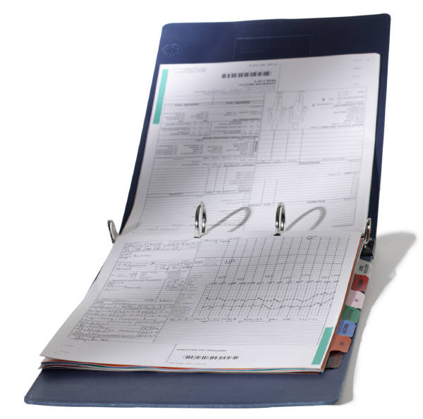
CPT (Current Procedural Terminology)
Evaluation and Management (E/M) Codes to be used by all physicians
  1995 required Multi-system Exam
  1997 introduced Specialty-specific Exam

Slide 19
Additional Documentation Requirements
CMS Two Special Conditions of Participation (CoP) for Psychiatric Hospitals
    Initial Psychiatric Evaluation
    Progress Notes
    Treatment Plan
    Discharge Summary
    History and Physical
Insurance Carrier LCD (LMRP)
Insurance specific requirements, e.g. Tricare
State specific requirements, e.g. Medicaid
Hospital specific requirements

Slide 20
CPT Coding Choices for Psychiatrists
        E/M Codes Psychiatry Family of Codes
          Inpatient *Psychotherapies
          Outpatient *Patient and/or family
          Consults *Family
          Nursing Homes *Group
          Residential Treatment *Other Psychotherapies
                *Crisis
                *Psychoanalysis
        *ECT
        *TMS

Slide 21
E/M Codes
Determined by the following elements:
  Type of Service (Initial visit, Consult, Existing patient, etc.)
  Site of Service (Inpatient, Outpatient, Nursing facility, etc.)
  Level of Service, which is determined by either:
    History, Exam, and Medical Decision Making
    (Documenting “By the Elements”) or
    Time spent in counseling and coordination of care (Documenting by “Time”)

Slide 22
E/M Codes
3 Key Components:
    History
    Examination
    Medical Decision Making
Contributory Components:
    Counseling
    Coordination of Care
    Nature of the Presenting Problem
    Time

Slide 23
DOCUMENTING “BY THE ELEMENTS”
The level of the E/M code is determined by:
“The nature of the presenting illness” (i.e. how sick/complicated is this patient)
and
The number of elements documented under:
    HISTORY
    EXAMINATION
    MEDICAL DECISION MAKING

Slide 24
E/M Codes
History and Examination components are divided into:
    Problem Focused
    Expanded Problem Focused
    Detailed
    Comprehensive
Medical Decision Making component is divided into:
    Straightforward
    Low
    Moderate
    High

Slide 25
HISTORY ELEMENTS
Chief Complaint or reason for encounter (CC)
History of Present Illness (HPI):
  Location, quality, severity, duration, timing, context,
  modifying factors, and associated signs and symptoms
Review of Systems (ROS)
  (1)Constitutional (e.g. fever, weight loss); (2) Eyes;
  (3) Ears, Nose, Mouth, Throat; (4) Cardiovascular
  (5) Respiratory; (6) Gastrointestinal; (7) Genitourinary;
  (8) Musculoskeletal; (9) Integumentary;
  (10) Neurological; (11) Psychiatric; (12) Endocrine;
  (13) Hematologic/Lymphatic;(14) Allergic/Immunologic
  Past, Family, and Social History (PFSH)

Slide 26
Determining Level of Complexity HISTORY
  Problem focused: Chief complaint; brief history of present illness or problem
  Expanded problem focused: Chief complaint; brief history of present illness; problem pertinent system review
  Detailed: Chief complaint; extended history of present illness; problem pertinent system review extended to include a review of a limited number of additional systems; pertinent past, family, and/or social history
  Comprehensive: Chief complaint; extended history of present illness; review of systems that is directly related to the problem(s) identified in the history of the present illness plus a review of all additional body systems; complete past, family, and social history

Slide 27
Psychiatry Specialty EXAM
    Mental Status Examination
    Orientation to Time, Place, and Person
    Attention Span and Concentration
    Recent and Remote Memory
    Language (e.g. naming objects, repeating phrases)
    Fund of Knowledge/Estimate of Intelligence
    Speech
    Mood and Affect
    Thought Process (e.g. rate of thoughts, logical vs. illogical, abstract reasoning, computation)
    Associations (e.g. loose, tangential, circumstantial, intact)
    Thought Content (including delusions, hallucinations, suicidal, homicidal, preoccupation with violence, obsessions)
    Judgment and Insight

Slide 28
Psychiatry Specialty EXAM
    CONSTITUTIONAL
    Vital Signs (any 3 of 7):
      Sitting or standing BP
      Supine BP
      Pulse rate and regularity
      Respiration
      Temperature
      Height
      Weight
      AND
    General Appearance
  MUSCULOSKELETAL
  Gait and Station OR Muscle Strength and Tone (with notation of any abnormal movements, etc.)

Slide 29
Determining Level of Complexity EXAM
  Problem focused: 1 to 5 elements identified by a bullet
  Expanded problem focused: At least 6 elements identified by a bullet
  Detailed: At least 9 elements identified by a bullet
  Comprehensive: Perform all elements identified by a bullet

Slide 30
Medical Decision-Making
  Divided into the following levels:
    Straightforward
    Low
    Moderate
    High
  Levels are based on:
    Number of Problems or Diagnoses
    Data reviewed or ordered
    Level of Risk

Slide 31
Determining Level of Complexity MEDICAL DECISION MAKING
The following table shows the progression of the elements required for each level of medical decision making. To qualify for a given type of decision-making, two of the three elements in the table must either meet or exceed the requirements for that type of decision making.
Type of Decision Making | Number of Dx or Treatment Options | Amount and/or Complexity of Data to Review | Risk of Complications and/or Morbidity or Mortality
Straight forward | Minimal | Minimal or None | Minimal
Low Complexity | Limited | Limited | Low
Moderate Complexity | Multiple | Multiple | Moderate
High Complexity | Extensive | Extensive | High

Slide 32
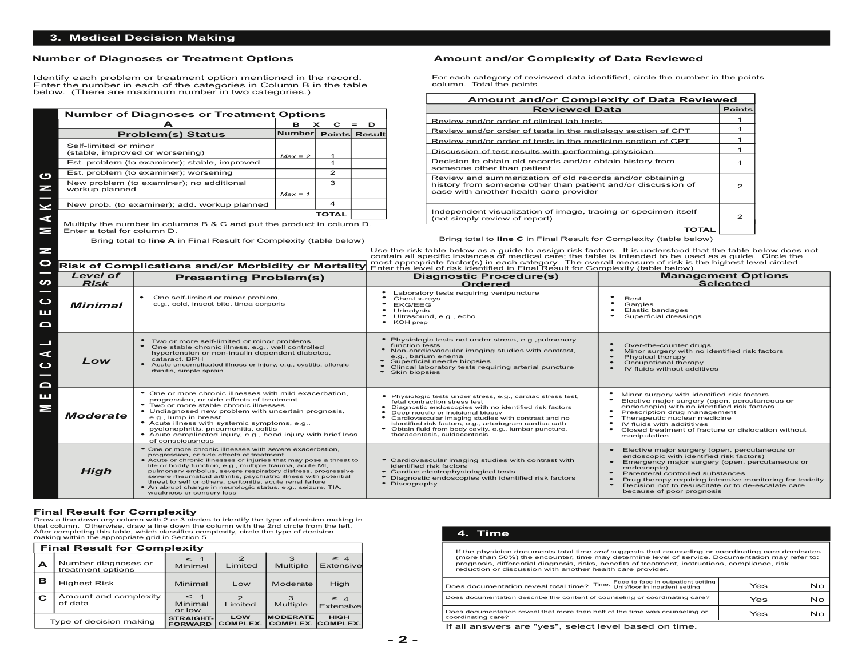
32

Slide 33
E/M Codes
Various Combinations of Levels of Complexity for each Component ➔ CPT Code➔ Payment

Slide 34
E/M: PUTTING IT ALL TOGETHER
HISTORY
  CHIEF COMPLAINT
  HISTORY OF PRESENT ILLNESS (HPI)
  REVIEW OF SYSTEMS (ROS)
  PAST, FAMILY, SOCIAL HISTORY (PFSH)
EXAMINATION
  MENTAL STATUS EXAMINATION
  CONSTITUTIONAL
  MUSCULOSKELETAL
MEDICAL DECISION MAKING
BY THE ELEMENTS:
Code Level Determined by:
Number of elements in HPI + ROS + PFSH
Number of Examination elements
Level of Medical Decision Making
OR
BY TIME:
Code Level Determined by Time Spent in Counseling and Coordination of Care (if greater than 50% of the time)

Slide 35
Billing Code: 99205
Comprehensive History
  Chief Complaint
  Extended HPI; Complete ROS; Complete PFSH
Comprehensive Exam
  All elements identified by a bullet
High Complexity Medical Decision Making
  Best 2 out of 3 of Extensive Number of Diagnoses/Problems; Extensive Amount and/or Complexity of Data; and High Level of Risk

Slide 36
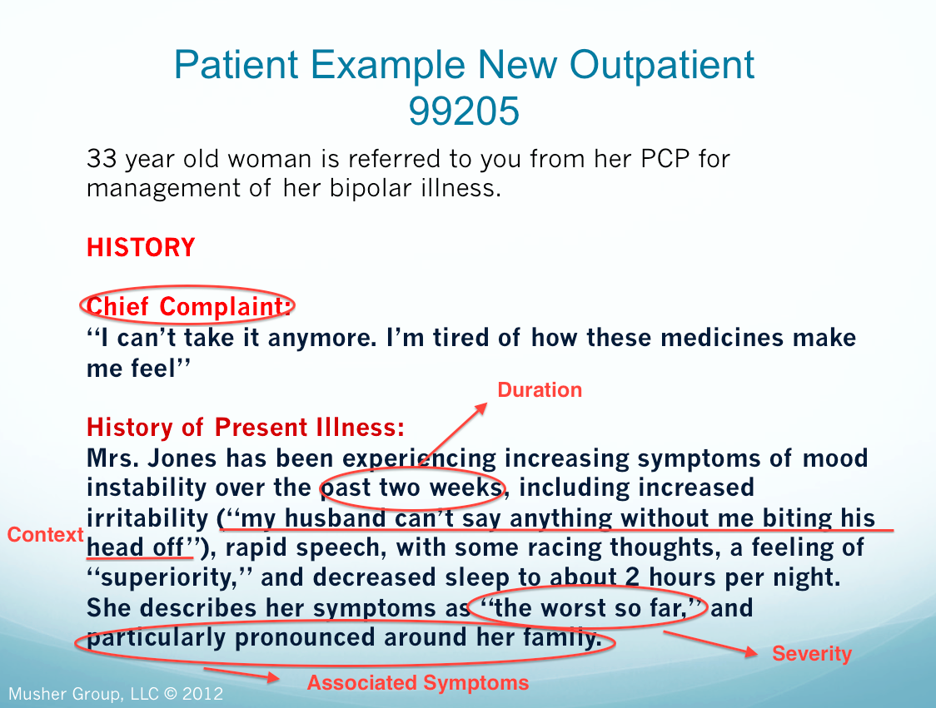

Slide 37
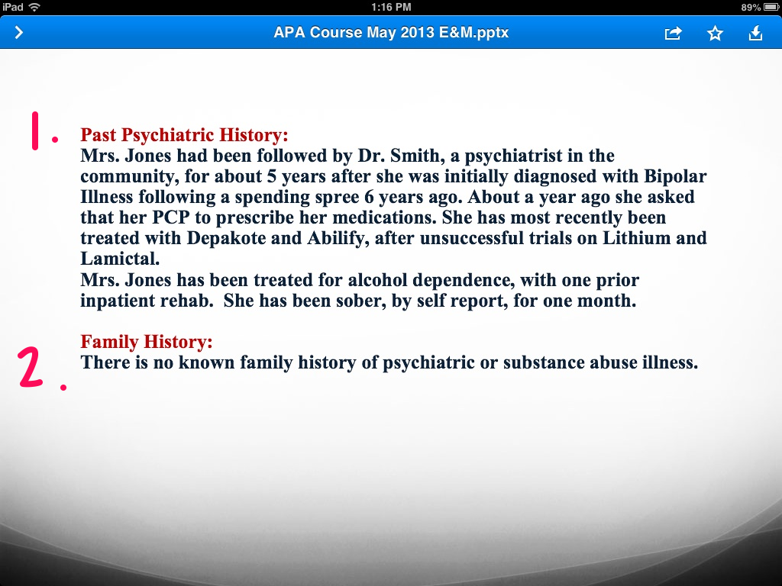

Slide 38


Slide 39
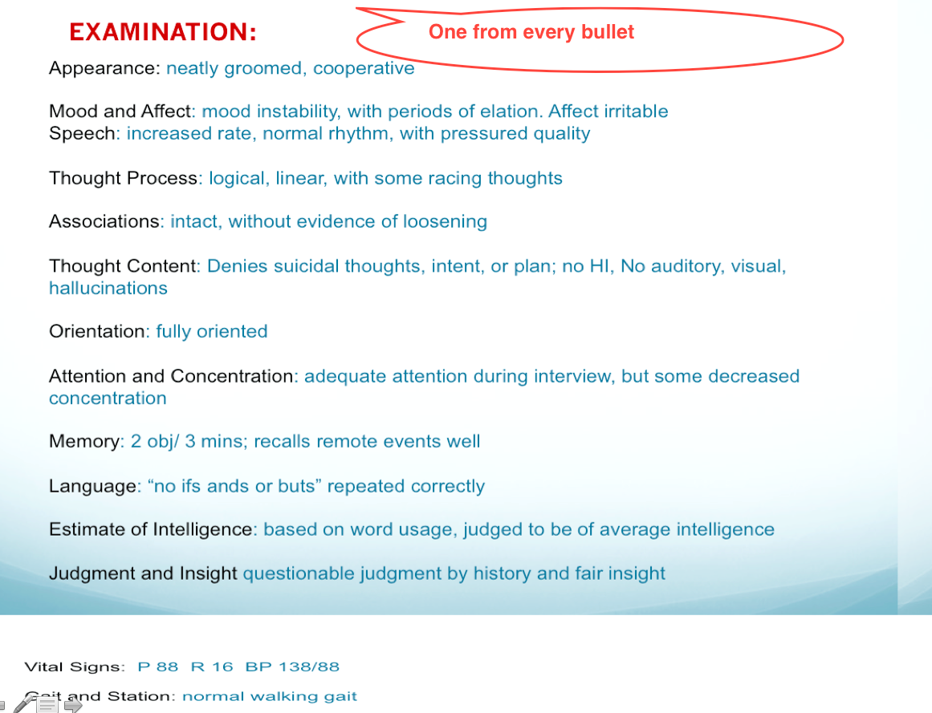

Slide 40
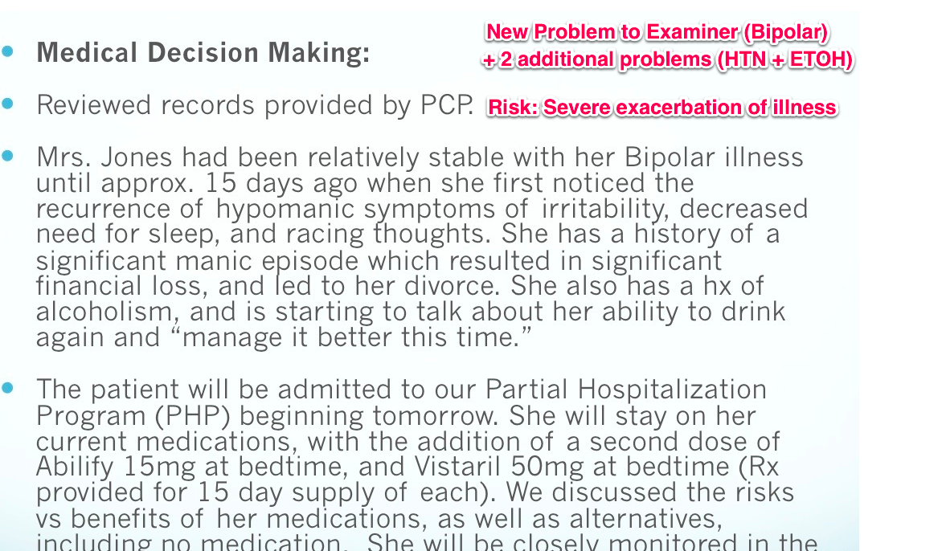

Slide 41
E/M and Psychotherapy

Slide 42

Psychotherapy
w/patient or family
When a Medical E/M Service is
Provided on Same Day Report:
99201-99255, 99304-99337,
99341-99350
Select Type & Level of E/M
based on: History, Exam and
Med Decision Making
Select Psychotherapy Add-on
based on: Time
Note: Same diagnosis may
exist for both Psychotx
& E/M Services
Psychotherapy:
90832 (30 Minutes)
90834 (45 Minutes)
90837 (60 Minutes)
E/M with Psychotherapy
Add-on:
90833 (30 Minutes)
90836 (45 Minutes)
90838 (60 Minutes)

Slide 43
HOW DO YOU CODE AND DOCUMENT E/M + PSYCHOTHERAPY?
The appropriate E/M code is selected on the basis of the level of work (ie, “key components,” which include history, examination, and medical decision making) and not on the basis of time.
When psychotherapy is provided on the same day as an E/M service, report add-on codes 90833 (30 minutes), 90836 (45 minutes), or 90838 (60 minutes) for psychotherapy to indicate that both services were provided.
The time spent providing the medical E/M service should not be included when selecting the timed psychotherapy code.

Slide 44
HOW DO YOU CODE AND DOCUMENT E/M + PSYCHOTHERAPY? (Cont’d)
The CPT Time Rule:
  A unit of time is attained when the mid-point is passed”
  When codes are ranked in sequential typical times and the actual time is between two typical times, the code with the typical time closest to the actual time is used.”
For Psychotherapy Times, the CPT Time Rule Applies:
  30-minute psychotherapy codes (90832 and +90833) can be used starting at 16 minutes
  45-minute psychotherapy codes (90834 and +90836) can be used starting at 38 minutes
  60-minute psychotherapy codes (90837 and +90838) can start to be used at 53 minutes

Slide 45
99214 Example:
E/M + Psychotherapy Add On
The psychotherapy service must be “significant and separately identifiable”

Slide 46
Patient: Robert Smith MR: 00023456
Date: November 12, 2013 Time: 1:45pm
CC: 13-year-old male seen for follow-up visit for mood and behavior problems. Visit attended by patient and father; history obtained from both.
HPI: Patient and father report increasing, moderate sadness that seems to be present only at home and tends to be associated with yelling and punching the walls at greater frequency, at least once per week, when patient frustrated. Anxiety has been improving and intermittent, with no evident trigger.
SH: Attending eighth grade without problem; fair grades
ROS: Psychiatric: no problems with sleep or attention ;Neurological: no headaches
Exam: Appearance: appropriate dress, appears stated age; Speech: normal rate and tone; Thought Process: logical; Associations: intact; Thought Content: no SI/HI or psychotic symptoms; Orientation: x3; Attention and Concentration: good; Mood and affect: euthymic and full and appropriate; Judgment and Insight: good
Assessment and Plan:
Problem #1: depression
Comment: worsening; appears associated with lack of structure
Plan: increase dose of SSRIs; write script; CBT therapy; return visit in two weeks
Problem #2: anxiety
Comment: improving
Plan: patient to work on identifying context in therapy
Problem #3: anger outbursts
Comment: worsening; related to depression but may represent new dysregulation
Plan: consider a mood stabilizing medication if no improvement in 1-2 months
Psychotherapy – approx.. 20 minutes
Type: CBT
Focus: reviewed prior plan and walked through steps to take when he first notices mood getting worse. Identified context for anxiety and developed plan. Provided workbook to complete and bring to next session.

Slide 47
Weekly Psychotherapy with E/M**
45 minute weekly psychotherapy appointments
Common
  99212 +90836 (38-52 mins)
  99214 +90833 (16-37 mins)
  Sometimes
  99213 +90836 (38-52 mins)
  Rarely
  99214 +90836 (38-52 mins)
**Typical Times:
99212 (10 mins)
99213 (15 mins)
99214 (25 mins)

Slide 48
Time to Practice What You’ve Learned
Clinical Vignette

Slide 49
[Video will be shown here]

Slide 50
SAMPLE Progress Note
Pam XXXXX MRN#: 123-45-6789
FEB 5, 2014 2:00PM
HISTORY [Expanded Problem Focused]
CC: Follow-up for depression and poor concentration
HPI: mood improved, but times when feel like crying, out of the blue, not at work, 2x in past 2 mos. In the evening, no ppt. Talking to daughter helps, and stays inside, walks the dog. No desire to do fun reading. Able to do job. Not hopeless, “just feels sad”
[Extended HPI: Duration, Context, Modifying Factors, Associated Signs and Symptoms]
ROS: Psychiatry: sleep, initial OK, mid night awakening and hard to fall back asleep; No audio/visual hallucinations
[Pertinent system – Expanded Problem Focused ]
PFSH:
[No PFSH]

Slide 51
SAMPLE Progress Note (cont’d)
EXAMINATION: [7 bulleted items EXPANDED PROBLEM FOCUSED EXAM]
APPEARANCE: appropriately dressed and groomed
ATTENTION AND CONCENTRATION: good attention, some complaint of difficulty concentrating, particularly at work; spells “GLOBE” forward and backward
MEMORY: 3/3, remote intact based on answers to interview questions
SPEECH: normal rate and rhythm, without pressured quality
MOOD AND AFFECT: “OK, a little nervous because I’m here;” sad affect
THOUGHT PROCESS: no complaints of slowed thinking
THOUGHT CONTENT: No delusions, AVH, worried not doing job as well as she can [LETHALITY ASSESSMENT]
MEDICAL DECISION MAKING
Problem #1: Mood
Comment: Continues with persistent sadness; difficulty concentrating; lack of pleasure
Plan: Increase Prozac to 60mg daily (from 40mg); Consider CBT if no improvement in 6-8 weeks
[NATURE OF THE PRESENTING PROBLEM: LOW TO MODERATE SEVERITY
PROBLEMS OR DIAGNOSES: 1Problem with inadequate improvement
RISK: LOW TO MODERATE]
CODE: 99213

Slide 52
Psychotherapy for Crisis

Slide 53
Crisis
Urgent
High Distress
Complex
Life Threatening

Slide 54
Psychotherapy for Crisis (90839, +90840)
Rationale:
New concept and addition to the psychotherapy section
When psychotherapy services are provided to a patient who presents in high distress with complex or life threatening circumstances that require urgent and immediate attention

Slide 55
Psychotherapy for Crisis
90839 is a stand-alone code not to be reported with psychotherapy or psychiatric diagnostic evaluation codes, the interactive complexity code, or any other psychiatry section code.
+90840 is an add-on code that should be reported for each additional 30 minutes of service.

Slide 56
Psychotherapy for Crisis Example:
36-year-old woman being treated for a Generalized Anxiety Disorder and relationship problems with Cognitive Behavior Therapy, calls and leaves a message that she is planning to commit suicide because she “can’t stand it anymore.” Her therapist is able to reach her on the phone and she agrees to come in for an urgent session in one hour. She arrives with her husband. The therapist attempts to defuse the crisis, meeting individually with the patient, and jointly with the husband. The patient remains suicidal, and agrees to hospitalization. The therapist makes arrangements for hospitalization and the patient is transported by ambulance. Total time spent on working with the patient and arranging for hospitalization is 95 minutes.
Codes: 90839, +90840

Slide 57
Coding Tips
Report 90839 for the first 30-74 minutes
of psychotherapy for crisis on a given date
Psychotherapy for crisis of less than 30 min. total should be reported with 90832 or 90833
Report 90839 only once per date even if time spent by the physician/QHCP is not continuous on that date
When service results in additional time, report +90840 with 90839 once for every additional 30 minutes of time beyond the first 74 minutes

Slide 58
HCPCS Codes
G0463, Hospital outpatient clinic visit for assessment and management of a patient; use this code when providing services paid under Medicare’s Partial Hospitalization Program (PHP) for outpatient E/M services 99201-99215 (OPPS Setting)
G0459, Telehealth inpatient pharmacy management; use this code when providing inpatient E/M services via telemedicine

Slide 59
Questions?

Slide 60
Practical E/M Coding Guidance

Slide 61
E/M Codes for Outpatient Follow-Up
Basic E/M rules
Nature of Presenting Problem/Reason for Encounter
Medical Decision Making
History
Examination

Slide 62
Level of Service
Outpatient, Consultations (Outpt & Inpt) and ER
 | Established Office Requires 2 components within shaded area
History | Minimal problem that may not require presence of any physician | PF | EPF | D | C
Examination |  | PF | EPF | D | C
MDM |  | SF | L | M | H
Average Time (minutes) ER has no average time | 5 (99211) | 10 (99212) | 15 (99213) | 25 (99214) | 40 (99215)
Level | I | II | III | IV | V
Medical decision making determined by 2 of 3, Risk/Data/Problems

Slide 63
Risk of Complications
Level of Risk | Presenting Problem(s) | Diagnostic Procedure(s) Ordered | Management Options Selected
Minimal | One self-limited or minor problem, e.g. cold, insect bite, tinea corporis | Laboratory test requiring venipuncture Chest x-rays EKG/EEG Urinalysis Ultrasound, e.g. echo KOH prep | Rest Gargle Elastic bandages Superficial dressings
Low | Two or more self-limited or minor problems One stable chronic illness, e.g. well-controlled hypertension or non-insulin dependent diabetes, cataract or BPH Acute, uncomplicated illness or injury, e.g. cystitis, allergic rhinitis, simple sprain | Physiologic tests not under stress, e.g. pulmonary function tests Non-cardiovascular imaging studies with contrast, e.g. barium enema Superficial needle biopsies Clinical laboratory tests requiring arterial punctures Skin biopsies | Over-the-counter drugs Minor surgery with no identified risk factors Physical therapy Occupational therapy IV fluids without additive
Moderate | One or more chronic illnesses with mild exacerbation, progression, or side effects of treatment Two or more stable chronic illnesses Undiagnosed new problem with uncertain prognosis, e.g. lump in breast Acute illness with systemic symptoms, e.g. pyelonephritis, pneumonitis, colitis Acute complicated injury, e.g. head injury with brief loss of consciousness | Physiologic tests under stress, e.g. cardiac stress test, fetal contraction stress test Diagnostic endoscopies with no identified risk factors Deep needle or incisional biopsy Cardiovascular imaging studies with contrast and no identified risk factors, e.g. arteriogram, cardiac cath Obtain fluid from body cavity, e.g. lumbar puncture, thoracentesis, culdocentesis | Minor surgery with identified risk factors Elective major surgery (open, percutaneous or endoscopic with no identified risk factors) Prescription drug management Therapeutic nuclear medicine IV fluids with additives Closed treatment of fracture or dislocation without manipulation
High | One or more chronic illnesses with severe exacerbation, progression, or side effects of treatment Acute or chronic illnesses or injuries that may pose a threat to life or bodily function, e.g. multiple trauma, acute MI, pulmonary embolus, severe respiratory distress, progressive severe rheumatoid arthritis, psychiatric illness with potential threat to self or others, peritonitis, acute renal injury An abrupt change in neurological status, e.g. seizure, TIA, weakness or sensory loss | Cardiovascular imaging studies with contrast with identified risk factors Cardiac electrophysiological tests Diagnostic endoscopies with identified risk factors Discography | 636363

Slide 64
Problem Points
Problems/Diagnosis | Points
Self-limited or minor (max of 2) | 1
Established problem, stable | 1
Established problem, worsening | 2
New problem, no additional work-up planned (max of 1) | 3
New problem, additional work-up planned | 4
Note:
“New or old” will be relative to the examiner, not the patient
Points are additive within the encounter

Slide 65
Elements of the HPI
Location – “Where is the pain/problem?”
Severity – “How bad is the pain/problem?”
Duration – “When did the pain/problem start?”
Quality – “What is the quality of the pain/problem?”
Timing – “Is the pain/problem constant or intermittent?”
Context – “In what setting did the pain/problem start?”
Modifying Factors – “What makes it better or worse?”
Associated Signs and Symptoms – “What are the
associated signs and symptoms?”

Slide 66
“Magic Formula” for HPI
“For (duration) has had (timing), (severity) problem when (context), (modifying factors), with (associated signs and symptoms).”
“For (how long) has had (intermittent/daily), (mild/moderate/severe) problem when (at work, home, alone, conflict,…), (better with x and worse with y), with (associated signs and symptoms).”
Missing Location and Quality

Slide 67
Level | Exam Bullets
Comprehensive | At least 1 bullet from the unshaded box AND every bullet in each of the shaded boxes
System/Body Area | Elements
Constitutional | Any 3 of the following VS: 1) sitting or standing BP, 2) supine BP, 3) PR and rhythm, 4) RR, 5) temp, 6) Ht, 7) Wt General appearance
Musculoskeletal | Muscle strength and tone; any atrophy or abnormal movements Examination of gait and station
Psychiatric | Speech – rate, volume, articulation, coherence, and spontaneity Thought Process – rate of thoughts, content, abstract reasoning, computation Associations (loose, tangential, circumstantial, intact) Abnormal psychotic thoughts – hallucinations, delusions, preoccupation with violence, homicidal or suicidal ideation, obsessions Judgment and Insight Complete Mental Status Examination: Orientation to time, place and person Recent and remote memory Attention span and concentration Language Fund of Knowledge Mood and Affect

Slide 68
Level of Service
Outpatient, Consultations (Outpt &Inpt) and ER
 | Established Office Requires 2 components within shaded area
History | Minimal problem that may not require presence of any physician | 3/8 | 3/8+1 ROS | 4/8+pfsh+… | 4/8+…
Examination |  | 1-5/15 | 6-8/15 | 9+ | all
MDM |  | 1 prob pt+med | 2 prob pts+med | 3 prob pts+med | 4 prob pts+ !
Average Time (minutes) ER has no average time | 5 (99211) | 10 (99212) | 15 (99213) | 25 (99214) | 40 (99215)
Level | I | II | III | IV | V

Slide 69
99213
1) NPP/RE – low to moderate – risk of morbidity low and full recovery expected to moderate risk of morbidity and uncertain prognosis or increased probability of prolonged functional impairment
2) Medical Decision Making- low complexity=meds (moderate risk) + 2 points under either data or problems
  or
3) EPF History (3 elements + 1 ROS)
  or
4) EPF Examination (6-8 elements)

Slide 70
99213 note (History)
Reason for visit: “A” return visit for follow-up of depression
Assessment: Depression, stable. New Problem of anorgasmia, presumably due to medication.
Plan: Wellbutrin add for augmentation/treatment for anorgasmia.
Prozac continue current.
Return visit 4 weeks, reviewed emergency contacts.
History: Last seen 4 weeks ago, since then mood improved, not to baseline. Continues to have episodic, breakthrough sad mood of moderate severity, lasting for greater than one hour average weekly. Generally precipitated by relationship issues.
ROS: Denies anxiety, reports normal sleep and appetite. Wt. stable. Denies history of suicide ideation.
Exam: …

Slide 71
99213 note (Exam)
Reason for visit: “B” returns for follow-up of depression
Assessment: Depression, stable. New Problem of anorgasmia, presumably due to medication.
Plan: Wellbutrin add for augmentation/treatment for anorgasmia.
Prozac continue current.
Return visit 4 weeks, reviewed emergency contacts.
History: …
Exam: Speech is articulate and coherent, of normal rate and volume. Thoughts are normal rate and reasoning. Associations intact. No abnormal thoughts, hallucinations or obsessions. Denies suicidal thought. Normal judgment and insight. Mood “up and down”, affect serious, stable.

Slide 72
99212
1) NPP/RE – self-limited or minor – definite and prescribed course, transient in nature, and not likely to permanently alter health status OR good prognosis with management/compliance
2) Medical Decision Making- straight-forward = meds (moderate risk) + ? (nothing really, but just one problem gets you there)
or
3) PF History (3 elements)
  or
4) PF Examination (1-5 elements)

Slide 73
99212 note (History)
Reason for visit: “C” returns for follow-up of depression
Assessment: Depression improving.
Plan: Wellbutrin continue 450 mg PO q AM
Return visit 6 weeks, reviewed emergency contacts.
History: Over last 4 weeks improving. Decreasing mild depression and associated normalizing neurovegetative function. Compliant with meds, denies side effects.
Exam: …

Slide 74
99212 note (Exam)
Reason for visit: “D” returns for follow-up of depression
Assessment: Depression improving.
Plan: Wellbutrin continue 450 mg PO q AM
Return visit 6 weeks, reviewed emergency contacts.
History:
Exam: Casually dressed and groomed. Speech is articulate and coherent. Thoughts show no abnormality, denies suicidal thought. Mood “good” affect euthymic.

Slide 75
99214
1) NPP/RE – Moderate to High severity- risk of morbidity without treatment moderate; moderate risk of mortality without treatment; uncertain prognosis OR increased probability of prolonged functional impairment
2) Medical Decision Making- moderate = meds (moderate risk) + 3 problem or data points
or
3) Detailed History (4 elements + 2-9 ROS and 1 PFSH)
  or
4) Detailed Exam (9 elements)

Slide 76
99214 note (History)
Reason for visit: “E” returns for follow-up of depression, complaining of new problems.
Assessment: Worsening depression, excessive sedation and weight gain.
Plan: Remeron taper to 7.5 mg by 7.5 mg every other day.
Prozac initiate and titrate, 20 mg PO q AM.
Return visit 4 weeks, reviewed emergency contacts
History: Over last 4 weeks reports worsening daily depressed mood. Mood improved when at work, worse when alone/at home. Now experiencing excessive sedation, sleeps 10 hours and has gained 15 pounds since starting Remeron.
PFSH: Has cut work schedule back to half-time.
ROS: Increased appetite and weight. No change in anxiety, denies history of suicide ideation.
Exam: …

Slide 77
99214 note (Exam)
Reason for visit: “F” returns for follow-up of depression, complaining of new problems.
Assessment: Worsening depression, excessive sedation and weight gain.
Plan: Remeron taper to 7.5 mg by 7.5 mg every other day.
Prozac initiate and titrate, 20 mg PO q AM.
Return visit 4 weeks, reviewed emergency contacts
History: …
Exam: BP 130/90; Pulse 72; RR 14; Wt 175
Casually dressed, less neatly groomed than baseline. Normal gait and station. Speech is articulate and coherent, normal rate and soft volume. Thought processes normal. Associations intact. Demonstrates no abnormal thoughts and specifically denies hallucinations, or suicidal thoughts. Normal judgment/insight. Mood “bad,” affect constricted, congruent with self-description with feeling sad.

Slide 78
E/M Coding
All Inpatient codes and all Outpatient high level codes (IV/V) require Comprehensive History which includes all 3 PFSH and complete ROS
High level codes all require Comprehensive Examination (Vital Signs)
Require all 3 (History/Exam and MDM), not just 2 of 3 as the subsequent visits do
Learn the Comprehensive History/Exam and always do that for your new patients, submitted code to be determined by level of Medical Decision Making.

Slide 79
Level of Service
Outpatient, Consultations (Outpt &Inpt) and ER
 | New Office / Consults / ER Requires 3 components within shaded area
History | PF ER:PF | EPF ER:EPF | D ER:EPF | C ER:D | C ER:C
Examination | PF ER:PF | EPF ER:EPF | D ER:EPF | C ER:D | C ER:C
MDM | SF ER:SF | SF ER:L | L ER:M | 3 prob pts+.. ER:M | 4 prob pts+.. ER:H
Average Time (minutes) ER has no average time | 10 New (99201) 15 Outpt cons (99241) 20 Inpt cons (99251) ER (99281) | 20 New (99202) 30 Outpt cons (99242) 40 Inpt cons (99252) ER (99282) | 30 New (99203) 40 Outpt cons (99243) 55 Inpt cons (99253) ER (99283) | 45 New (99204) 60 Outpt cons (99244) 80 Inpt cons (99254) ER (99284) | 60 New (99205) 80 Outpt cons (99245) 110 Inpt cons (99255) ER (99285)
Level | I | II | III | IV | V

Slide 80
Level of Service
Hospital Care
 | Initial Hospital/Observation Requires 3 components within shaded area |  |  | Subsequent Hospital Requires 2 components within shaded area
History | D/C | C | C | 3/8 Interval | 3/8 Interval | 4/8 Interval
Examination | D/C | C | C | 1-5/15 | 6-8 | 9+
MDM | SF/L | M | H | 1-2 prob pts+… | 3 prob pts+… | 4 prob pts+…
Average Time (minutes) Observation has no average time | 30 Init hosp (99221) Observ care (99218) | 50 Init hosp (99222) Observ care (99219) | 70 Init hosp (99223) Observ care (99220) | 15 Subsequent (99231) | 25 Subsequent (99232) | 35 Subsequent (99233)
Level | I | II | III | I | II | III

Slide 81
Psychiatry Audit Worksheet for E/M Services

Slide 82
Questions?

Slide 83
Special Settings/ Circumstances
Allan Anderson, MD, CMD, DFAPA

Slide 84

Presenter – Allan Anderson, MD, CMD, DFAPA
Medical Director, Samuel and Alexia Bratton Memory Clinic, Easton, Maryland
Alternate Representative, AMA/Specialty Society RVS Update Committee (RUC)
Immediate Past President, AAGP
Member, APA Committee on RBRVS, Codes and Reimbursement

Slide 85
Disclosure
As the APA alternate representative to the AMA RVS Update Committee (RUC) I receive reimbursement for expenses of attending the RUC meetings but no additional remuneration for time.

Slide 86
Coding for special situations
Coding in Long-Term Care: NF and ALF
Selecting Appropriate Code by Time
Transition Care Management Codes
Chronic Care Coordination Codes
Interactive Codes
“Incident To”

Slide 87
Long-Term Care Coding
87

Slide 88
Nursing Facility Codes
Initial Visit Codes
  99304 (25)
  99305 (35)
  99306 (45)
Subsequent Visit Codes
  99307 (10)
  99308 (15)
  99309 (25)
  99310 (35)

Slide 89
ALF Codes
Initial Visit Codes
  99324 (20)
  99325 (30)
  99326 (45)
  99327 (60)
  99328 (75)
Subsequent Visit Codes
  99334 (15)
  99335 (25)
  99336 (40)
  99337 (60)

Slide 90
Comparing NF to ALF - Initial visit
Nursing Home
  99304 (25)
  99305 (35)
  99306 (45)
Assisted Living
  99324 (20)
  99325 (30)
  99326 (45)
  99327 (60)
  99328 (75)

Slide 91
Comparing NF and ALF - Subsequent visit
Nursing Facility
  99307 (10)
  99308 (15)
  99309 (25)
  99310 (35)
Assisted Living
  99334 (15)
  99335 (25)
  99336 (40)
  99337 (60)

Slide 92
ALF and Nursing Facility Codes
Initial ALF Subsequent ALF
CPT Code History Exam MDM CPT Code History Exam MDM
99324 PF PF STF 99334 PF PF STF
99325 EPF EPF LOW 99335 EPF EPF LOW
99326 DET DET MOD 99336 DET DET MOD
99327 COMP COMP MOD 99337 COMP COMP HIGH
99328 COMP COMP HIGH
Initial Nursing Facility Subsequent Nursing Facility
CPT Code History Exam MDM CPT Code History Exam MDM
99304 DET DET STF 99307 PF PF STF
99305 COMP COMP MOD 99308 EPF EPF LOW
99306 COMP COMP HIGH 99309 DET DET MOD
99310 COMP COMP HIGH

Slide 93
99308 and 99335
Consider these as “base codes” and the necessary elements are identical to the elements for 99213
Performed less work? – code 99307 or 99334
Performed more work? – code 99309 or 99336
Remember that for the higher codes history is either detailed or comprehensive, exam requires more elements, and MDM is either moderate or high

Slide 94
Rarely Used by Psychiatrists
99318 – Nursing Facility Annual Assessment
99315 – Nursing Facility Discharge <30 minutes
99316 – Nursing Facility Discharge >30 minutes

Slide 95
Coding by Time
When greater than 50% of the time on the floor/unit (inpatient/nursing home) or face-to-face (outpatient) is spent on counseling and coordination of care, TIME is the sole determining factor of the E/M code.
The provider must document the total time related to that patient on the floor/unit (inpatient/nursing home) or face-to face with the patient (outpatient) and must specify the time spent counseling and/or coordinating care, and provide a summary of the encounter.
The key components: history, exam, and medical decision making do not determine the code if TIME is used instead.

Slide 96
Counseling and Coordination of Care
Counseling is defined as a discussion with the patient and/or family or other care giver concerning one or more of the following: diagnostic results, prognosis, risks and benefits of treatment, instructions for management, compliance issues, risk factor reduction, patient and family education.
Coordination of care is defined as discussions about the patient’s care with other providers or agencies
96

Slide 97
Basing code on time in LTC
Remember that for nursing facility as well as inpatient hospital we go by floor or unit time, not face-to-face time
Face-to-face time in the ALF
Remember to document total time and time spent on counseling and coordination of care
Remember what C&C is and what C&C is not. Failure to do so may negate your use of C&C and code then falls back to the elements of Hx, Exam, and MDM

Slide 98
Chronic Care Management Services
At the time this presentation was submitted Chronic Care Management was being discussed in detail at both the RUC and CPT. The following information was current as of the date of submission. We will be provide an update at the May presentation
98

Slide 99
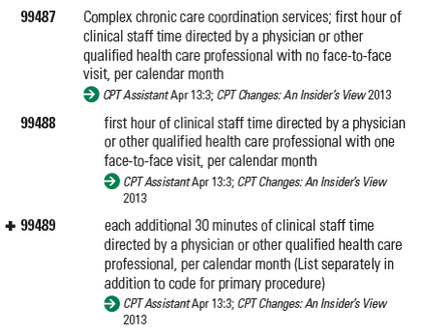
CCC Codes
99

Slide 100
Chronic Care Management Services
Beginning in January 2015, CMS will recognize one G-Code for Chronic Care Management Services
20 minutes or more of service during a 30-day period
Code is for patients with 2 or more chronic conditions that are expected to last at least 12 months or until death, and the patient is at significant risk of death, acute exacerbation/decompensation, or functional decline.
Requires
24 hr/day; 7 days/week access to EHR
Continuity of care with a designated practitioner
Care management for chronic conditions, including systematic assessment of the patient’s medical, functional, and psychosocial needs; medication reconciliation; patient centered focus
Management of care transitions
Coordination with home/community based clinical care services
Enhanced communication opportunities – phone, secure messaging, internet, non-synchronous, non-face-to-face methods
Written or electronic version of care plan must be provided to patient
Cannot use this code if you are also billing transitional care management, home health care supervision, hospice supervision, or ESRD

Slide 101
Transitional Care Management Codes
CPT Codes 99495 (14 day post disch) and 99496 (7 day disch) are used
to report transitional care management services (TCM).
A new or established patient whose medical and/or psychosocial problems require moderate or high complexity medical decision making during transitions in care from an inpatient hospital setting, partial hospital, observation status in a hospital, or skilled nursing facility/nursing facility to the patient’s community setting (home, domiciliary, rest home, or assisted living).
TCM commences upon the date of discharge and continues for the next 29 days.
Only one physician can report these services and the services are reported/billed on the 30th day post discharge. The work includes a face-to-face visit as well as non-face-to-face services performed by the physician and/or their staff.
You cannot bill the TCM codes and the care management codes for the same patient

Slide 102
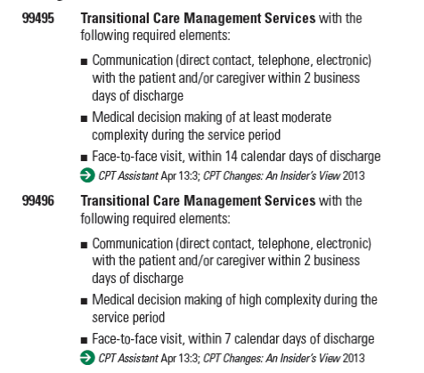
TCM Codes

Slide 103
Interprofessional Telephone/Internet Consultations – NEW in 2014
This service is an assessment and management service in which a patient’s treating physician (or other qualified healthcare professional) seeks the opinion and/or treatment advice of a physician with specific specialty expertise to assist the treating physician (or other qualified health care professional) in the diagnosis and/or management of the patient’s problem without the need for face-to-face contact between the patient and the consultant.

Slide 104
Interprofessional Telephone/Internet Consultations
These services are typically provided in complex and/or urgent situations where a face-to-face visit with the consultant may not be possible
These codes should not be reported by a consulting physician if they have accepted a transfer of care
If the service results in a face-to-face visit with the consultant within 14 days, do not report these codes
Documentation of the request by the treating physician should be made in the medical record, along with documentation of the verbal report followed by a written report from the consultant
This is not a covered service under Medicare

Slide 105
Interprofessional Telephone/Internet Consultations

Slide 106
“Incident To”

Slide 107
Use of “Incident to”
Clinician must be licensed to perform that service
Clinician cannot perform initial evaluation
You have to initiate the treatment that will then be continued by the clinician
Periodically you must see the patient to review treatment progress

Slide 108
“Incident to” is “invisible” to insurer
You submit your charges, not the clinician’s charges

Slide 109
“Incident To” Issues
Supervision?
Site of service?
Provider status?
Red Flag? – Be tight on documentation

Slide 110
Questions?

Slide 111
Interactive Complexity
CPT add-on code 90785
Add-on code background
  Designated with “+” prefix in CPT
  May only be reported in conjunction with specified other codes (“primary procedure”)
  Never reported alone
  Describes 4 types of communication difficulties that complicate the primary procedure
  Describes types of patients and situations most commonly associated with interactive complexity
  Commonly present during visits by children and adolescents but may apply to visits by adults, as well

Slide 112
Four specific communication factors
Maladaptive communication
Interference from caregiver emotions or behaviors
Disclosure and discussion of a sentinel event
Language difficulties (play therapy)
* Complicates work and occurs during the
psychiatric procedure

Slide 113
May be reported in conjunction with
  Psychiatric diagnostic evaluation (90791, 90792)
  Psychotherapy (90832, 90834, 90837)
  Psychotherapy add-on (90833, 90836, 90838) when reported with E/M
  Group psychotherapy (90853)
May not be reported in conjunction with E/M alone or any other code

Slide 114
The Communication Factors
Interactive complexity may be reported when at least one of the following communication factors is present:
  The need to manage maladaptive communication (related to, e.g., high anxiety, high reactivity, repeated questions, or disagreement) among participants that complicates delivery of care
  Caregiver emotions or behavior that interfere with implementation of the treatment plan
  Evidence or disclosure of a sentinel event and mandated report to a third party (e.g., abuse or neglect with report to state agency) with initiation of discussion of the sentinel event and/or report with patient and other visit participants
  Use of play equipment, physical devices, interpreter or translator to overcome barriers to diagnostic or therapeutic interaction with a patient who is not fluent in the same language or who has not developed or lost expressive or receptive language skills to use or understand typical language

Slide 115
Maladaptive Communication
  The need to manage maladaptive communication (related to, e.g., high anxiety, high reactivity, repeated questions, or disagreement) among participants that complicates delivery of care
Vignette (reported with 90834, psychotherapy 45 min)
  Psychotherapy for an older elementary-school-aged child accompanied by divorced parents, reporting declining grades, temper outbursts, and bedtime difficulties. Parents are extremely anxious and repeatedly ask questions about the treatment process. Each parent continually challenges the other’s observations of the patient.

Slide 116
Caregiver Emotions or Behavior
  Caregiver emotions or behavior that interferes with implementation of the treatment plan
Vignette (reported with 90832, psychotherapy 30 min)
  Psychotherapy for young elementary-school-aged child. During the parent portion of the visit, mother has difficulty refocusing from verbalizing her own job stress to grasp the recommended behavioral interventions for her child.

Slide 117
Sentinel Event
  Evidence or disclosure of a sentinel event and mandated report to a third party (e.g., abuse or neglect with report to state agency) with initiation of discussion of the sentinel event and/or report with patient and other visit participants
Vignette (reported with 90792, psychiatric diagnostic evaluation with medical services)
  In the process of an evaluation, adolescent reports several episodes of sexual molestation by her older brother. The allegations are discussed with parents and report is made to state agency.

Slide 118
Language Barriers and disabilities
  Use of play equipment, physical devices, interpreter or translator to overcome barriers to diagnostic or therapeutic interaction with a patient who is not fluent in the same language or who has not developed or lost expressive or receptive language skills to use or understand typical language
Vignette (reported with 90853, group psychotherapy)
  Group psychotherapy for an autistic adult who requires physical devices to follow the conversation in the group
90785 generally should not be billed solely for the purpose of translation or interpretation services or for patients
who require assistive devices due to a disability

Slide 119
Psychotherapy Time with 90785
When performed with psychotherapy
  Interactive complexity component (90785) relates ONLY to the increased work intensity of the psychotherapy service
  90785 does NOT change the time for the psychotherapy service

Slide 120
Questions?

Slide 121
Payer Issues/
APA Efforts
David Nace, MD

Slide 122

Presenter – David Nace, MD
McKesson Corporation, VP Clinical Development
APA Advisor, AMA CPT Editorial Panel
Member, APA Committee on RBRVS, Codes and Reimbursements

Slide 123
Feedback Through the APA Helpline
Fees/Fee Schedules
  No fee schedules or low fees
Ongoing Audits of 99214s and 99215s
Documentation
  No documentation of psychotherapy
  Insufficient documentation of E/M services
  No documentation of time spent performing psychotherapy

Slide 124
APA Activities
Lawsuit(s)
Ongoing outreach via phone, in-person meetings, and letters

Slide 125
Questions?

Slide 126
APA Resources/
Additional Assistance

Slide 127
Where to learn more
APA has developed educational materials and opportunities for APA members that can be found on the APA website at www.psychiatry.org/practice
Things such as:
A CPT coding crosswalk
On-line course on E/M coding and documentation
Live and recorded Webinars on E/M coding
APA CPT Coding Network (for questions by email)

Slide 128
Contact APA for Additional Help
You can reach CPT coding staff in the APA’s Office of Healthcare Systems and Financing:
Call the Practice Management Helpline – 1-800-343-4671,
or
Email – hsf@psych.org

Slide 129
Questions?

Slide 130
Thank you

